Slide 1
Automated Teller Machine (ATM)

Slide 2
Introduction :
This machine was originally created for dispending cash to customers and
Helps them to check their account balance.
1) Welcome page
2)Login page
3)Menu page
3.1) Balance enquiry
3.2) Balance withdraw
3.3) Mini statement
3.4) Quit

Slide 3
Flow chart :
welcome
Log in
Balance enquiry
Pin
file
Menu
Balance withdraw
Error Message
Mini statement
Quit

Slide 4
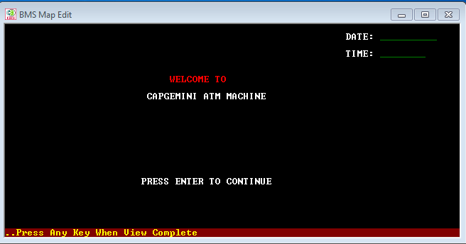
Welcome page :

Slide 5
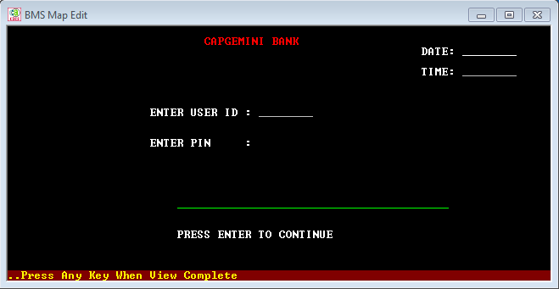
Login page :

Slide 6
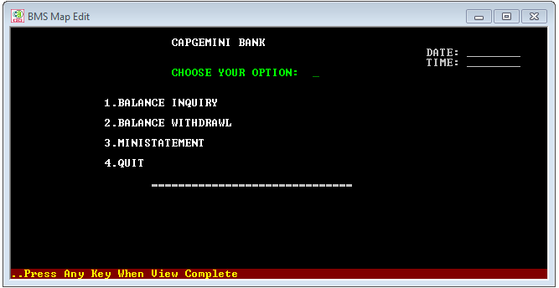
Menu page :

Slide 7
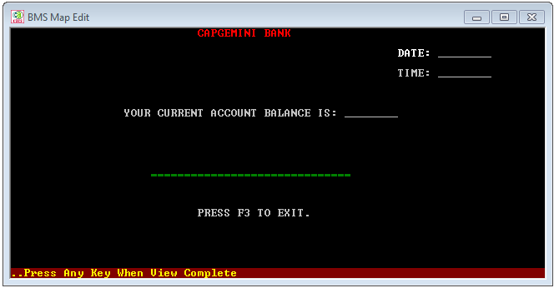
Balance enquiry :

Slide 8
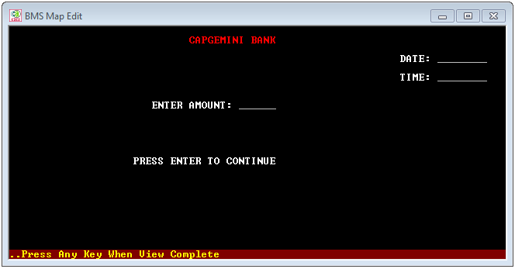
Balance withdraw :

Slide 9
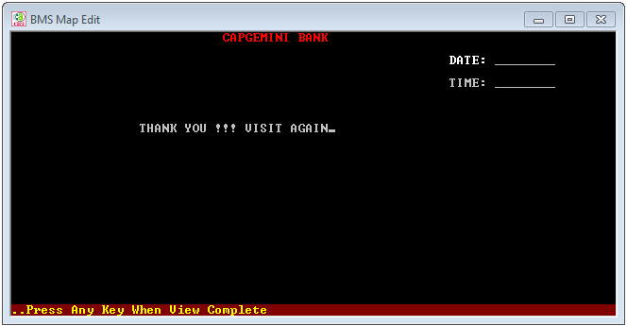
Quit :

Slide 10
THANK YOU

